Slide 1

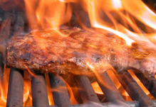
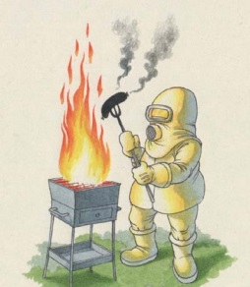
METHODS OF HEAT TRANSFER
CONDUCTION
CONVECTION
RADIATION
PHYSICS: FUN EXCITING SIMPLE
ptD_transfer.ppt

Slide 2

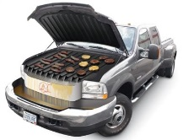
 METHODS OF HEAT TRANSFER
energy transfer (heat, Q)
due to a temperature difference, ΔT
CONDUCTION
CONVECTION
RADIATION
Q_{net}
Environment, T_{E}
system, T
European heat wave, 2003 ⇒ ~35 000 deaths in France

Slide 3
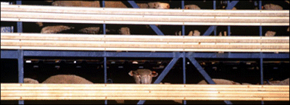
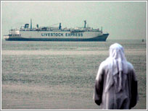
Live sheep trade
Sunday, October 26, 2003
Sheep to shore ... finally
The Labor Opposition will pursue the Government over the cost of the "ship of death" saga, which ended on Friday when 50,000 Australian sheep at sea for three months began being unloading in Eritrea.

Slide 4
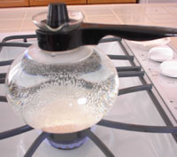
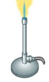
Heat Conduction
Conduction is heat transfer by means of molecular agitation within a material without any motion of the material as a whole.
If one end of a metal rod is at a higher temperature, then energy will be transferred down the rod toward the colder end because the higher speed particles will collide with the slower ones with a net transfer of energy to the slower ones.
T_{C}
T_{H}
conduction though glass
Q
Q

Slide 5
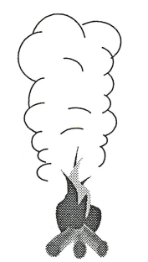
Heat Convection
Convection is heat transfer by mass motion of a fluid such as air or water when the heated fluid is caused to move away from the source of heat, carrying energy with it.
Convection above a hot surface occurs because hot air expands, becomes less dense and rises (natural or free). Convection assisted by breeze, pump or fan – forced convection.
Hot water is likewise less dense than cold water and rises, causing convection currents which transport energy.

Slide 6
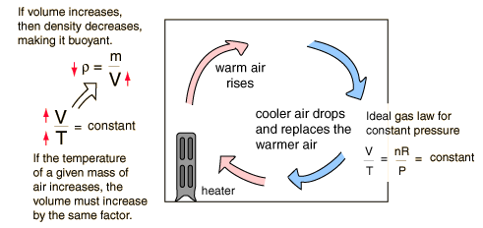
http://hyperphysics.phy-astr.gsu.edu/hbase/thermo/heatra.html

Slide 7
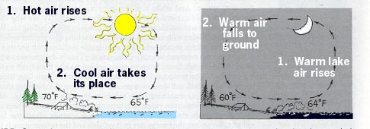
Sea & Land Breezes, Monsoons
35 ºC
20 ºC
11 ºC
17 ºC
What is the role of
heat capacity, c of water and soil?
http://sol.sci.uop.edu/~jfalward/heattransfer/heattransfer.html

Slide 8
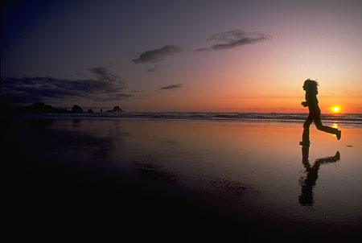
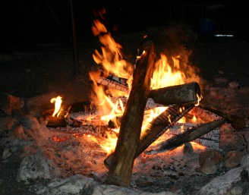
RADIATION
Energy transferred by electromagnetic waves
All materials radiate thermal energy in amounts determined by their temperature, where the energy is carried by photons of light in the infrared and visible portions of the electromagnetic spectrum.
Thermal radiation wavelength ranges:
IR ~ 100 - 0. 8 μm
Visible ~ 0.8 - 0.4 μm 800 – 400 nm
UV ~0.4 - 0.1 μm
For exam: more detail than in the textbook

Slide 9
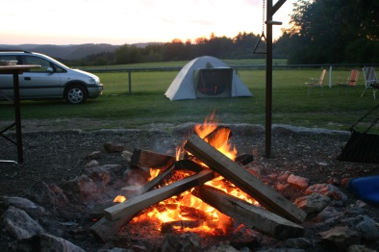
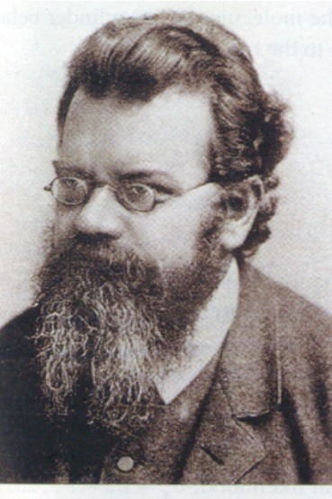
Ludwig Boltzmann
(1844-1906)
All objects above absolute zero emit radiant energy and the rate of emission increases and the peak wavelength decreases as the temperature of object increases

Slide 10
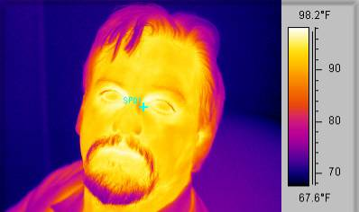
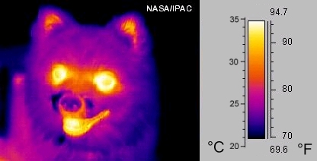
Thermography

Slide 11
A blackbody absorbs all the radiation incident upon it and emits the max possible radiation at all wavelengths
A graybody is a surface that absorbs a certain proportion of the energy of a blackbody.

Slide 12
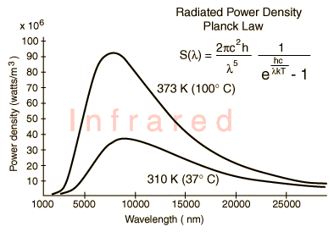
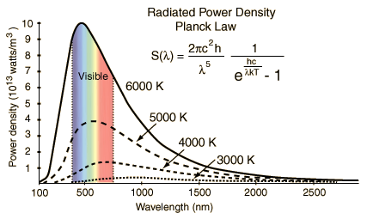
Sun (6000 K - hot!)
Earth (300 K - cold!)
Visible radiation
Infrared radiation

Slide 13
Sun & Photosynthesis
T_{Sun} ~ 6000 K
λ_{peak} ~ 480 nm (blue/green)
UV (ionization of molecules) ~ 9%
Visible (excite molecules) ~ 49 %
IR (warm) ~ 42%
0.1% of radiant energy captured by chlorophyll of plants
What about life on Earth if the Sun was hotter or colder ?

Slide 14
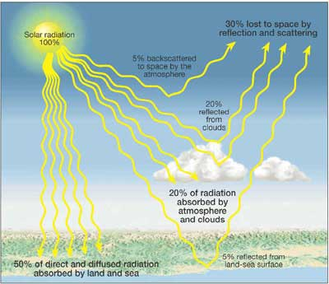
Greenhouse Effect
Earth’s albedo (reflectivity)
α_{Ε} = 0.3

Slide 15
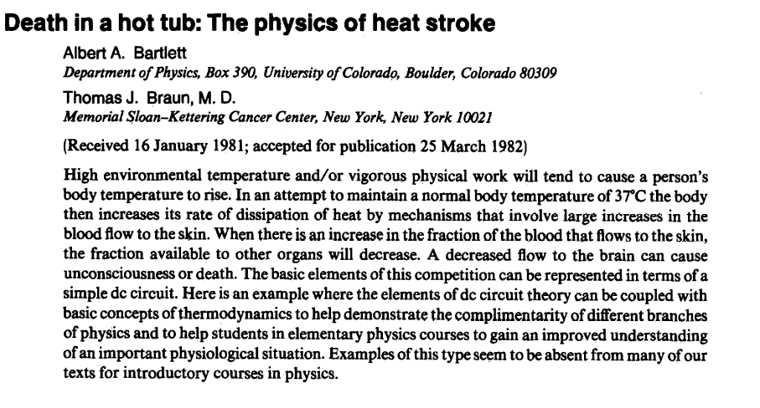
American Journal of Physics: Feb 1983

Slide 16
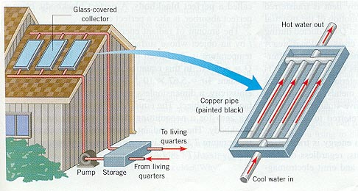
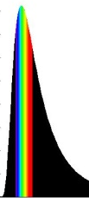
Selective surfaces
Emissivity, e – the nature of the surface
Value of e is temperature and wavelength dependent
e
Selective surface used in solar collectors
1
0
short long
λ
Good emitter / absorber at short wavelengths
λ
Poor emitter / absorber
at long wavelengths

Slide 17
1
Black paint
1
Black skin
e
e
White paint
White skin
0
0
short long
λ
short long
λ
Black skin absorbs heat more readily than white skin but also radiates heat more readily - the heat balance favours black skin in the tropics

Slide 18
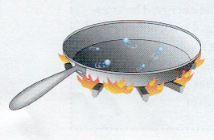
Why do droplets of water dance over the very hot pan ?
http://sol.sci.uop.edu/~jfalward/heattransfer/heattransfer.html

Slide 19
Why do droplets of water dance over the very hot pan ?
Water at the bottom of the drops is evaporated and provides insulation against further evaporation.
http://sol.sci.uop.edu/~jfalward/heattransfer/heattransfer.html

Slide 20
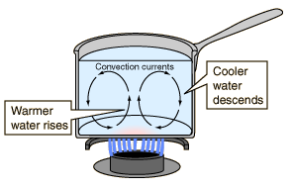
CONVECTION
Why not heat the water at the top?
http://hyperphysics.phy-astr.gsu.edu/hbase/thermo/heatra.html

Slide 21
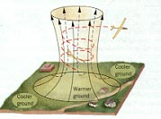
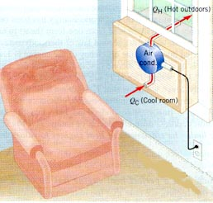
CONVECTION
Warm air rises above the ground
Forced convection
http://sol.sci.uop.edu/~jfalward/heattransfer/heattransfer.html

Slide 22
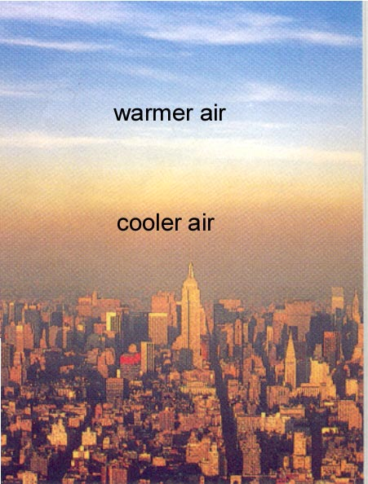
CONVECTION
Why do we get this pollution haze?
Temperature inversion prevents air rising and the dispersing the pollution
http://sol.sci.uop.edu/~jfalward/heattransfer/heattransfer.html

Slide 23
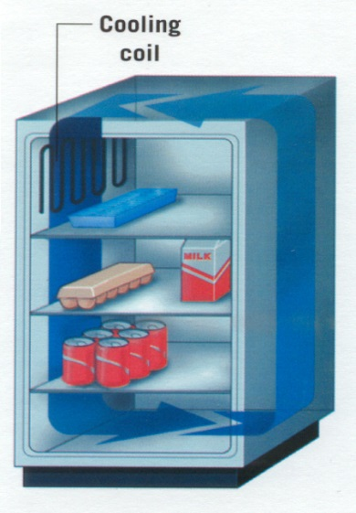
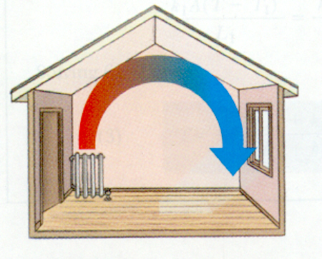
CONVECTION
In bathrooms, the heater is often near the ceiling. Problem ?
Why are the cooling coils at the top ?
http://sol.sci.uop.edu/~jfalward/heattransfer/heattransfer.html

Slide 24
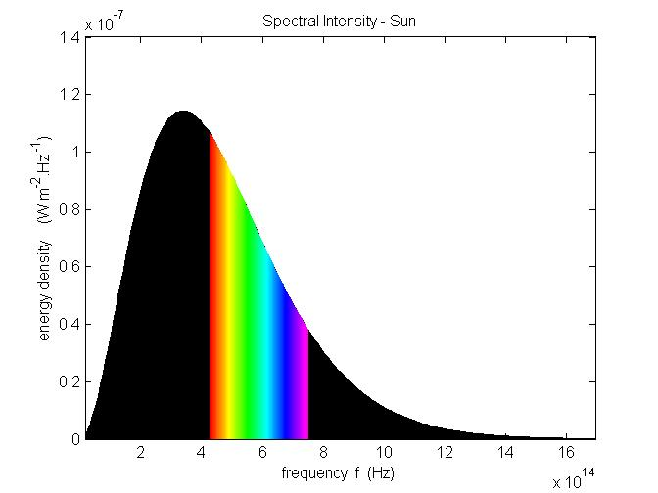

RADIATION
Wien constant
b_{f} = 2.83 k_{B}/h s⁻¹.K

Slide 25
RADIATION
Why are pipes in solar panels painted black ?
http://sol.sci.uop.edu/~jfalward/heattransfer/heattransfer.html

Slide 26
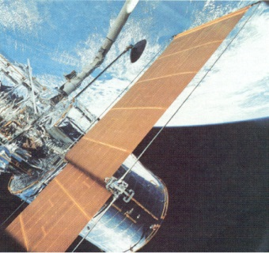
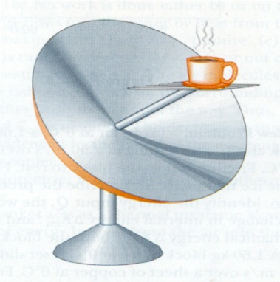
RADIATION
Highly reflecting metal foil keeps
inside temperature low.
http://sol.sci.uop.edu/~jfalward/heattransfer/heattransfer.html

Slide 27
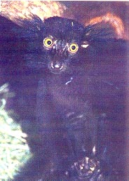
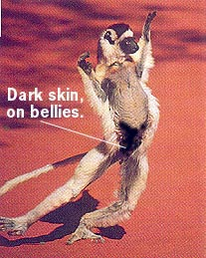
RADIATION
Lemur at left is nocturnal,
so the dark fur poses no
disadvantage in absorbing
excessive sunlight.
Lemur at the right is active
during the day; it points
its belly toward the sun on
cold mornings.
http://sol.sci.uop.edu/~jfalward/heattransfer/heattransfer.html

Slide 28
Think about
* Two different materials at the same temperature have different emissivities. Which one glows the brightest?
* Why are fireplace pokers made of iron and not copper?
* Some animals have hair which is composed of solid tubular strands, while others have hollow, air-filled tubes. Where would one more likely find the latter animal: In cold climates, or warm?
* Steel reinforcement bars add stability to concrete walls. Do they also enhance the insulating value of concrete?
* Wind chill factor
* Drapes hung close to a cold window

Slide 29
* Clothing
* Should you lower the blinds and draw the curtains on a hot day?
* When one steps from a shower on a cold morning, why does
the tile floor seem so much colder than the air?
* Place a wooden spoon and a metal spoon in the freezer. Which will
cool faster? After several hours, what would they feel like?
* Why do people become "flushed" when overheated?

